Slide 1
Rate of Chemical Reactions
Chapter 1 2020

Slide 2
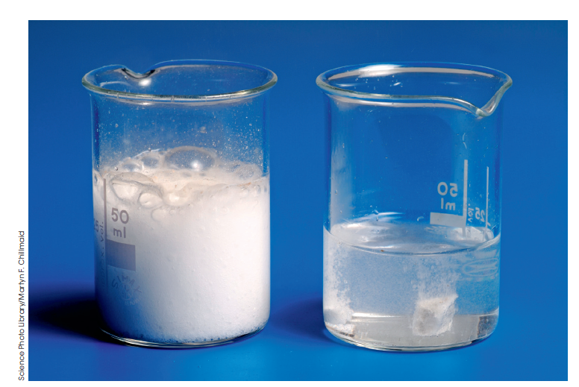
The rate of a reaction
Rate is how quickly one quantity changes compared to another quantity.

Slide 3
Measuring the rate of a reaction
Rate of a reaction is
the change in one measurable quantity over the change in time.
Measurable quantities for reactions:
mass
colour
volume
pH
concentration
Pressure of gas

Slide 4
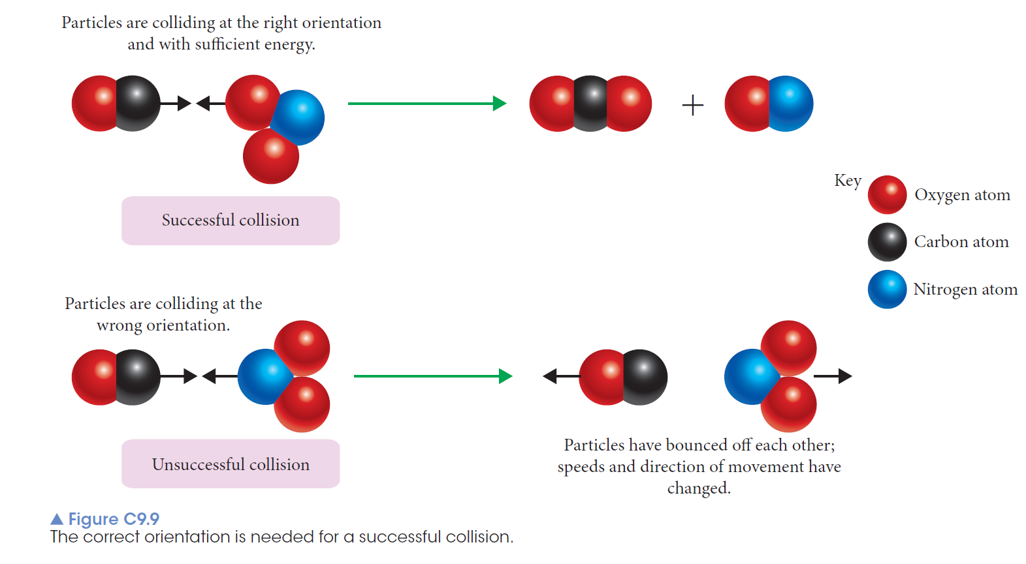
Collision theory
Reactants must collide with sufficient energy and in an appropriate orientation for a reaction to occur.

Slide 5
A successful collision has sufficient energy and an appropriate orientation to allow old bonds to be broken and new bonds to be formed.
An unsuccessful collision is one in which the energy and/or orientation are not satisfactory.
The more successful collisions there are in a given time, the faster the rate of the reaction because more reactants are forming products.

Slide 6
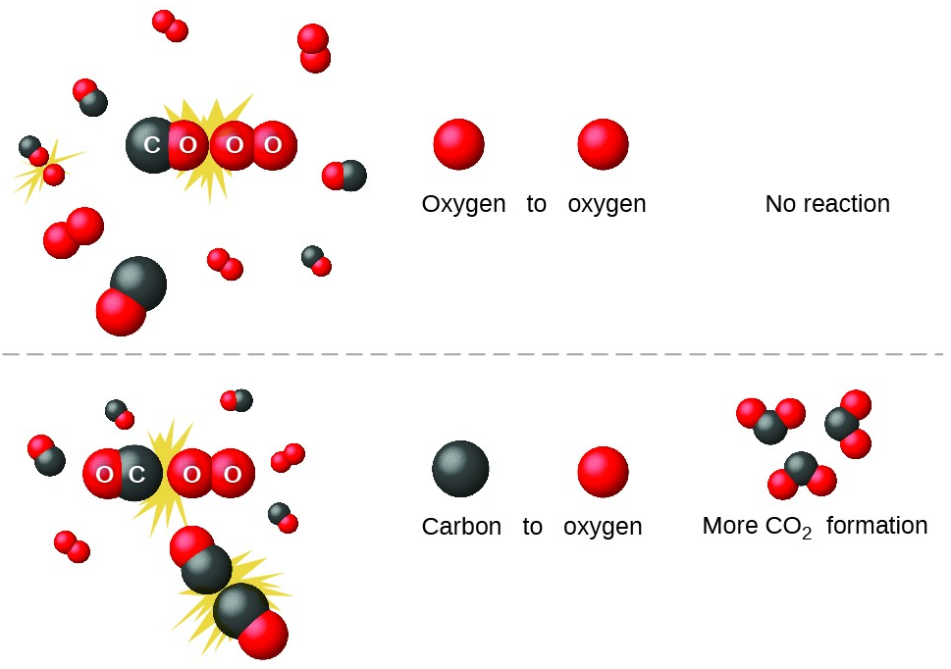
Correct Orientation
Correct orientations allows breaking of existing bonds and formation of new bonds.
Colliding particles have reactive sites, the suitable orientation can lead to a reaction between colliding particles.

Slide 7
Energy Changes in a Chemical Reaction
System + Surroundings energy = Remains constant -> law of conservation of energy.
Enthalpy H – Total energy (potential + kinetic Energy)
Enthalpy Change = H
H= H _{Products} - H _{reactants}

Slide 8
Sufficient Energy
A certain amount of kinetic energy is required to bond breaking and formation process.
If the colliding particles have sufficient energy they will collide to form transition state aka Activated Complex
Activated complex- Highest Potential energy state, original bonds are broken, new bonds are formed, highly unstable state, decomposes quickly to form either original reactants or new products.
Activated energy Ea ⁻ The minimum collision energy required to form the transition state.

Slide 9
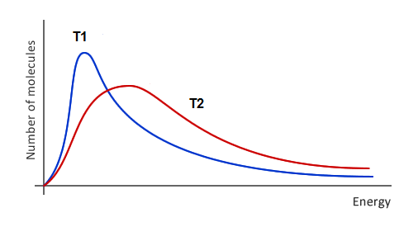
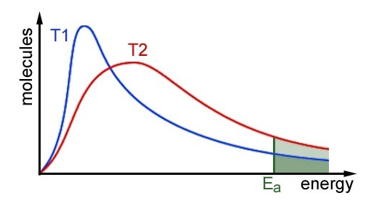
Maxwell-Boltzmann Distribution
At T2 more particles have sufficient energy.

Slide 10
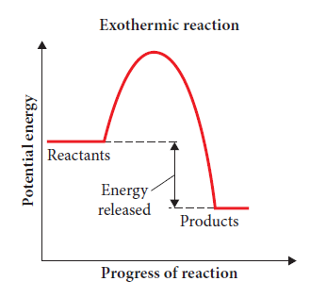
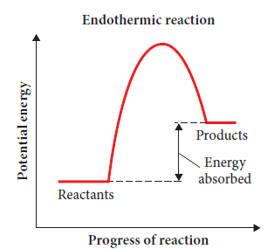
Energy profile diagrams
Enthalpy or heat content (H) is the total energy possessed by a chemical substance.
Energy profile diagrams show the enthalpy of the reactants, activated complex and products.
H = H _{Products}- H _{Reactants}
_{Where} H _{is change in enthalpy}
_{H is enthalpy}

Slide 11
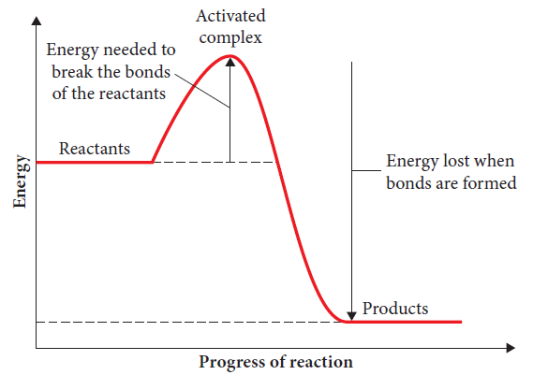
Activation energy
The amount of energy needed to form the activated complex ‒ E_{a}
The E_{a} is the:
Energy needed to break the bonds of the reactants
the minimum energy required for a reaction to occur.
The activation energy is the difference in energy between the activated complex and the reactants.
It influences the rate of reaction.

Slide 12
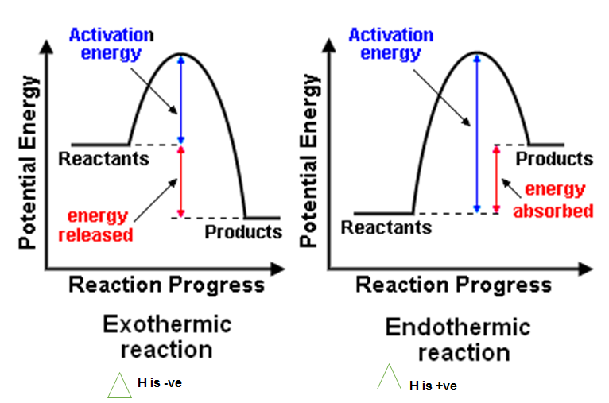
Energy Profile Diagrams

Slide 13
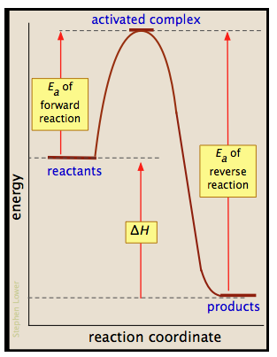
Ea of Forward and Reversed Reactions
Fw Reaction is Exothermic
Rv Reaction is Endothermic

Slide 14
Factors affecting reaction rate
Surface area
Concentration of reactants in a solution
Temperature
Gas pressure
Presence of a catalyst
They all lead to – grater number of collision and increasing probability of successful collisions.

Slide 15
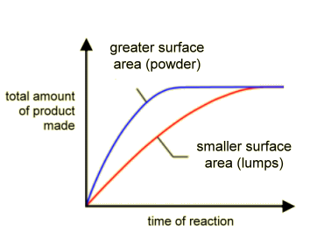
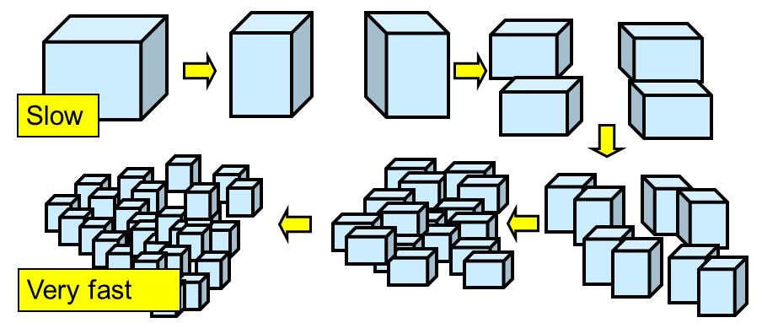
Surface area
Grinding or breaking a solid into smaller pieces.
Total greater surface area
Increased frequency of collisions per unit time
Results in a higher number of successful collisions.
Increased rate of reaction.

Slide 16
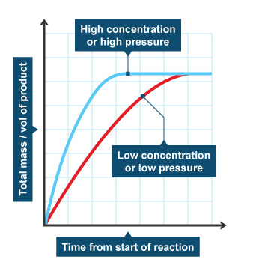
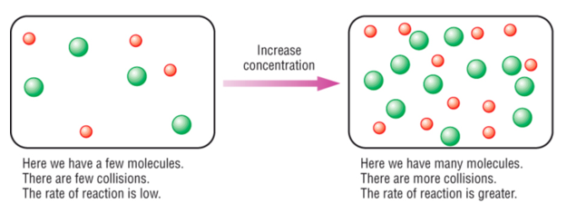
Concentration
Number of particle/ unit volume
More concentration = more particles= more successful collision
Higher rate of reaction

Slide 17
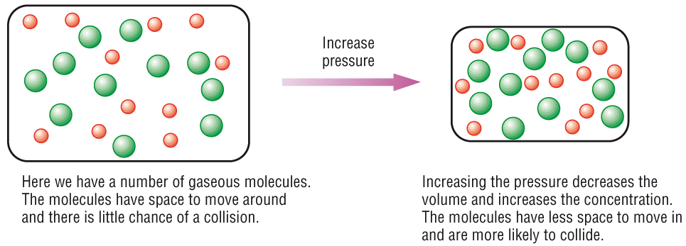
Gas Pressure
Raising the Pressure, (reducing volume/adding more gas particle to a fixed volume)
Increased frequency of collisions.
Results in a higher number of successful collisions
Higher rate of reaction.
Partial Pressure- Individual gas pressures, in a mixture of gases.
Increasing the pressure on a reaction involving reacting gases increases the rate of reaction.

Slide 18
Temperature
Raising the temperature, always increases the rate of reaction. Both endothermic and exothermic reactions.
Higher temp, particles have a greater kinetic energy.
Rate of collision b/w particles increase.(minor effect)
Average collision energy of reacting particles increases. (major effect)
Greater percentage of collisions will have sufficient energy to form an activated complex.
Reaction rate increases.

Slide 19
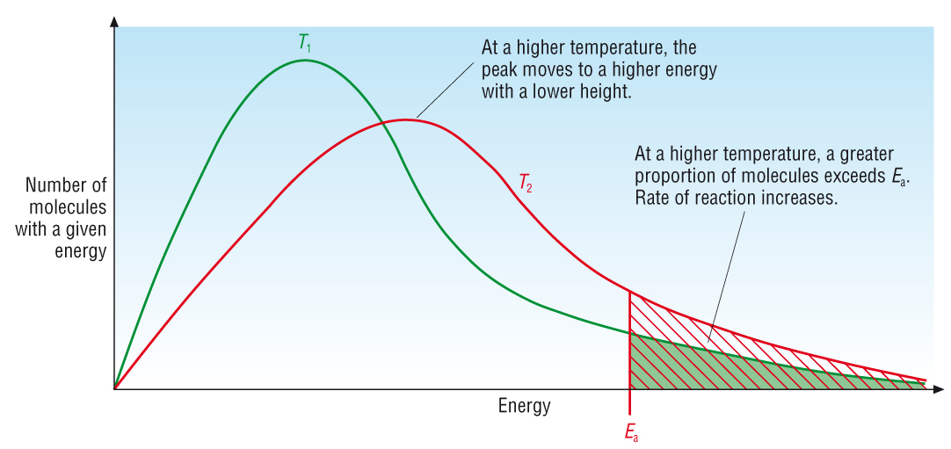
Temperature

Slide 20
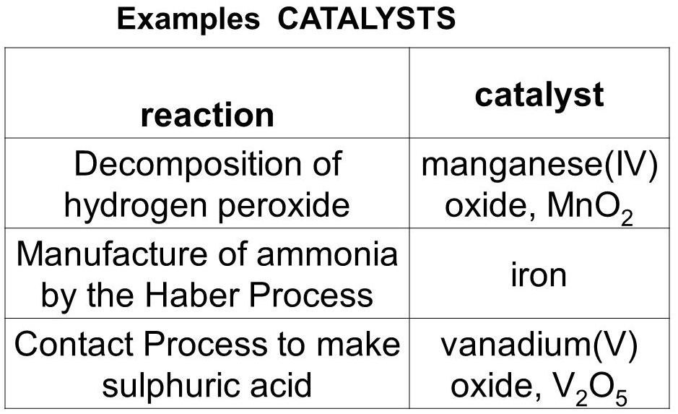
Catalyst
Provides an alternative reaction pathway with lower Ea.
Greater proportions of the reactants particles will have the sufficient energy.
More successful collisions
Higher reaction rate.

Slide 21
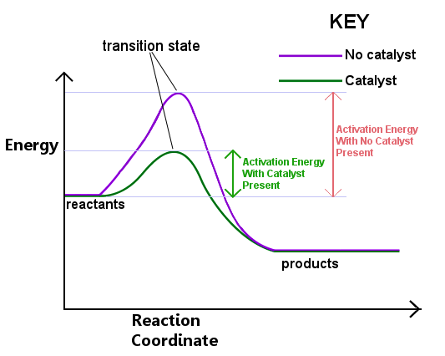
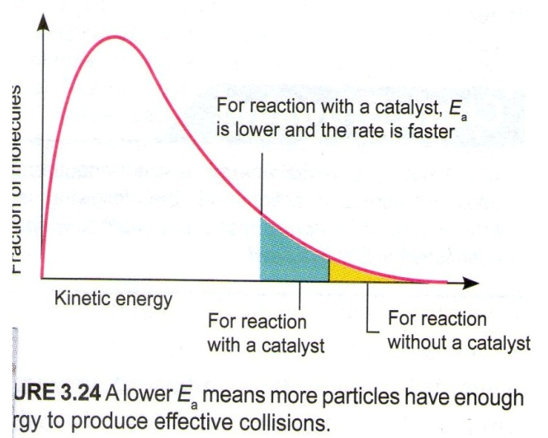
Catalysts

